Slide 1
VITEA VOCATIONAL ITINERARY IN TRAINING AND EDUCATION IN AGRICULTURE OR VITICULTURE AND EDUCATION FOR ALL TYPES OF LEARNERS http://www.vitea-vinepruning-erasmus.com/ ERASMUS+ STRATEGIC PARTNERSHIP FOR VET2015-2017

Slide 2
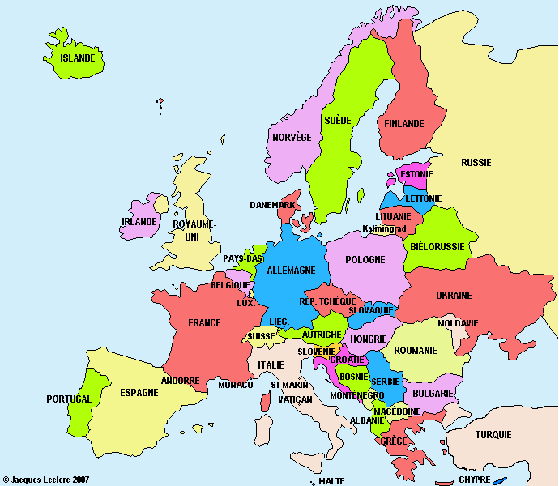
11 PARTNERS 7 PAYS
8 WINE SCHOOLS 2 COMPANIES
1 REGIONAL PUBLIC BODY
EPLEFPA PERIGORD FR
WBS KREMS
AT
BANTON ET LAURET FR
GEORGIKON GK MESZSZK SATORALJAUJHELY HU
XUNTA DE GALICIA
SP
FM DUNATI VILLANY HU
CIFP A GRANXA SP
GRM NOVO MESTO SLO
EPA MIRANDELA PT
ISSS CONEGLIANO IT
PROGETTO AGRICOLTURA SIENA IT

Slide 3
Objective: The professionalisation of vine pruners
Why
- Employers lack of competent (skilled) workers
- Workers shun low-paid seasonal work
- The training centers are obliged to consider the labor market needs
=> Win-win deal:
- enhanced competences - stabilization in employment - better incomes - adapted training

Slide 4
Pedagogic implementation
VITEA uses ECVET
ECVET is based on the Learning Outcomes (Learning Outcomes:LO)
- what a learner Knows, Understands and Implements - described in Knowledge, Skills and Competence (K,S,C)
ECVET ensures
- transferability from one country to another - institutional recognition - accumulation of these Units of Learning Outcomes (ULO)

Slide 5
Pedagogic implementation
VITEA uses ECVET
- Joint construction of tools for
- pedagogical teams: LO (K,S,C), ULO, Assessment grids … - mobility management: MoU, LA, EUROPASS
- Evaluation by foreign trainers
- Validation by the national trainer
- Recognition in a national certification …
- Certification for blocks of competence or for a full job
=> Each partner will advance as fast as possible in its national context

Slide 6
Content
To meet employers’ and workers’ needs
=> VITEA focuses on winter pruning: the heart of the job
2 levels
- vine pruning => level 3 of European Qualification Framework (EQF)
- advanced vine pruning => level 4 of EQF
2 pruning workshops for 2 pruners of each level by country
- 1 test and 1 assessment (AT)
- for learners and … teachers

Slide 7
Content
To meet learners' need => The VITEA project defines what they have to know
Prerequisites - knowledge - skills - competences
Assessment conditions - knowledge of assessment grid - abroad in English - by foreign trainers
Taking into account their results in - VITEA : certificate of pruning
- heir training course: validation in a module...
-

Slide 8
Practical implementation (Gantt Diagram)
Principles
- go to each educational partner once
- two partners are responsible for each action
- an external assessor follows our project
Meetings
4 multiplier events - national and pedagogical => standards (repository) (HU) - european and technical => operational guide (AT) … - european and institutional => recognition (SP) - worldwide and professional => results (FR)
3 activities => - 1 ECVET training (SLO) - 2 assessment sessions (IT, AT)
7 transnational meetings => - validation of work performed - definition and planning of future work

Slide 9
BERGERAC
KICK OFF MEETING
WORKING ON VITEA PROJECT MANAGEMENT
VISIT OF CHATEAU SOUTARD IN SAINT EMILION

Slide 10
SLOVENIA
ECVET TRAINING
WORKING ON ECVET
TASTING WINES
IN HISTORIC WINE SCHOOL CELLAR

Slide 11
KREMS
PRACTICAL EVALUATION
THIERRY, PABLO AND LUIS HARMONIZETHEIR ASSESSMENT
JOSIANE ASSESSES PRUNING
OF A HUNGARIAN LEARNER

Slide 12
LEARNERS ASSESSED IN KREMS
JOHANN, JULIEN, MICKAEL AND CHRISTOPHE PRESENT THEIR VITEA CERTIFICATE

Slide 13
SANTIAGO DE COMPOSTELA
FINAL MEETING
IN THE GALICIAN VINEYARD OF RIO MINHO
AFTER EFFORT, VINEYARD VISITS

Slide 14
VITEA 2
Thank you for your attention

