Slide 1
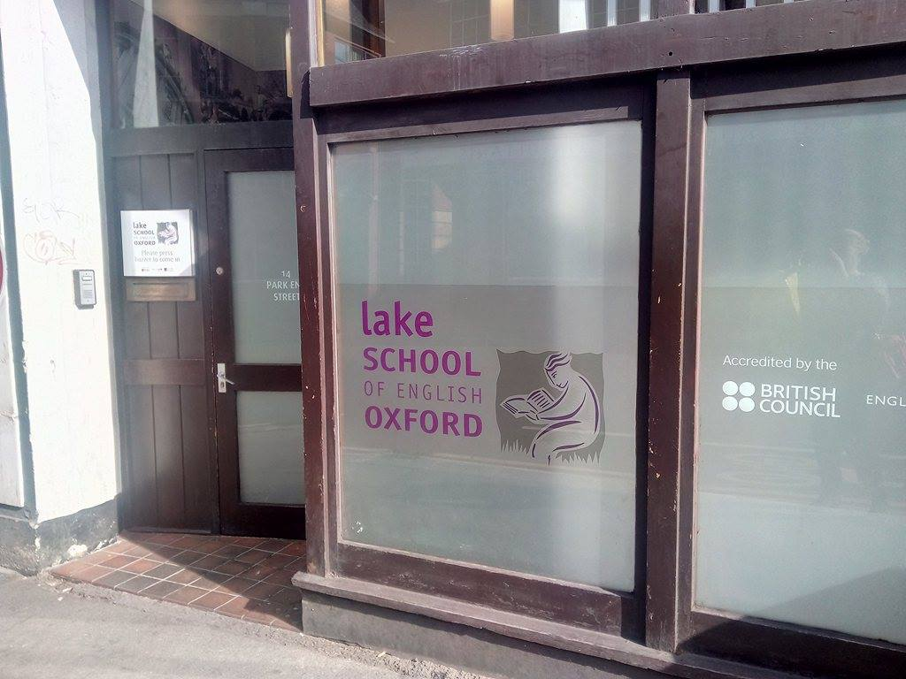
Oxford 2017.05.07-19

Slide 2
My home

Slide 3
The River Thames

Slide 4
Lake School of Oxford

Slide 5
Classmates

Slide 6
During lesson

Slide 7
Our teacher,Lucy Holmes

Slide 8
My certificate & methodology what I’ve learned

Slide 9
Using images & working with texts

Slide 10
Teaching phrasal verbs by act it out & Euphemism

Slide 11
Teaching idioms

Slide 12
Dictogloss by gap filling „The great white shark” (200- kg fibreglass)

Slide 13
Teaching pronouncation „da da language”

Slide 14
Social events: Visit a local secondary school „Oxford Spires”

Slide 15
Multicultural school: Indian,Chinese,Arabic

Slide 16
Mathematics

Slide 17
Blenheim Palace in Woodstock (1705-1722)

Slide 18
Visiting London:Big Ben

Slide 19
London Eye & Trafalgar Square,Nelson’s Coloumn

Slide 20
Good bye Oxford

